Slide 1



Software Engineering for Data Scientists
Knowledge and solutions for a changing world
Advancing data-intensive discovery in all fields
Be boundless
UW DIRECT
(Dystopian Inquiry & Research Emphasizing Culture & Technology)
https://uwdirect.github.io
David A. C. Beck (dacb)
Chemical Engineering & eScience Institute

Slide 2
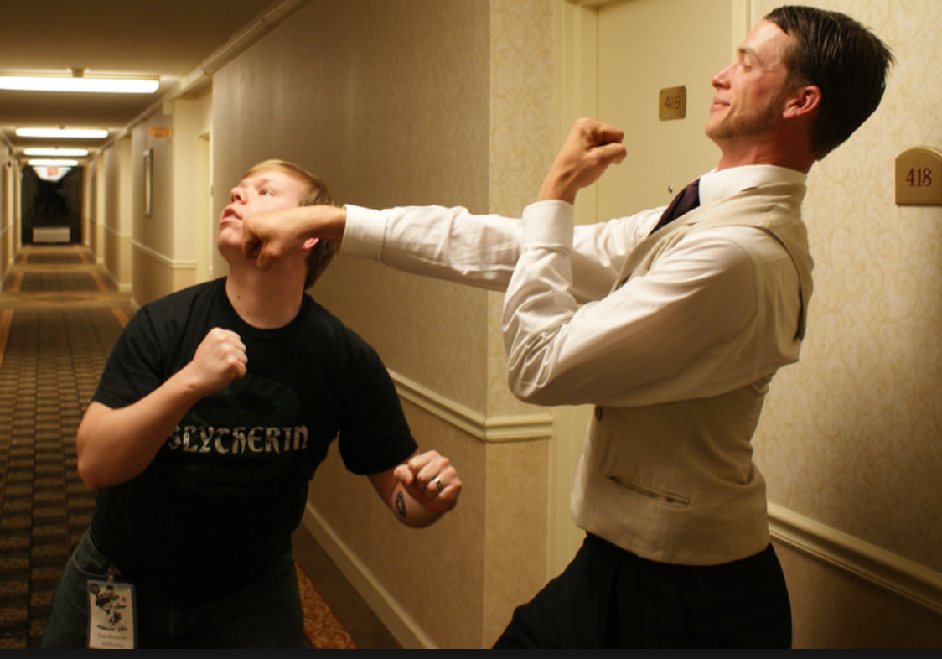
Agenda
X
Review
Collaborating with GitHub
Conflicts
Hands on conflicts
Branching and merging
Tags

Slide 3
Review
How do I...
view the change history for the repository?
see what files in the directory are modified from the last commit?
examine the changes between modified files and the last commit?
place a modified file into the staging area?
move the staged files into the repository history?

Slide 4
Review
What is...
the master branch?
HEAD?
HEAD~3?
How do I restore a previous version of a file? What verb?

Slide 5
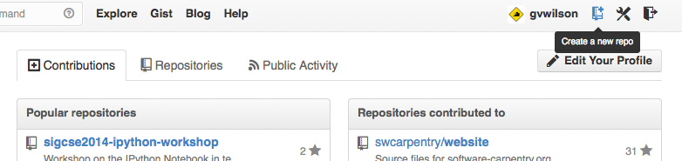

Slide 6
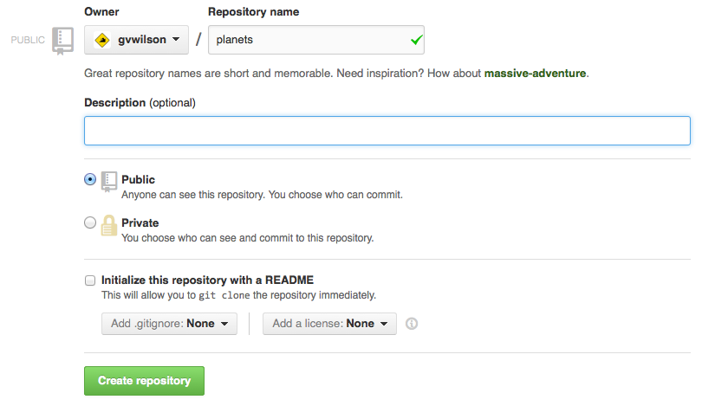

Slide 7
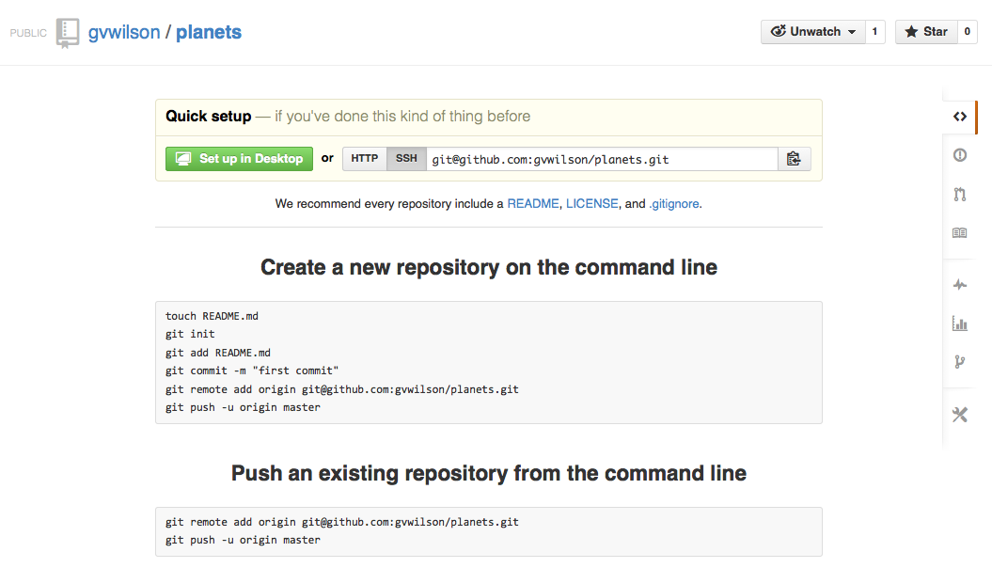

Slide 8
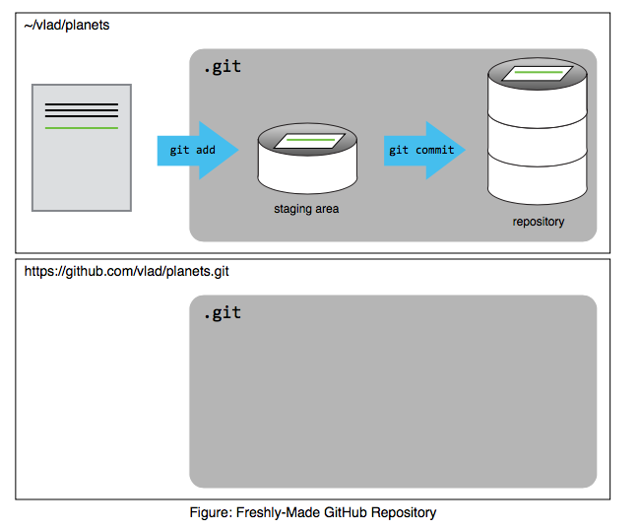

Slide 9
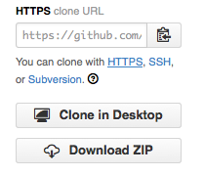

Slide 10
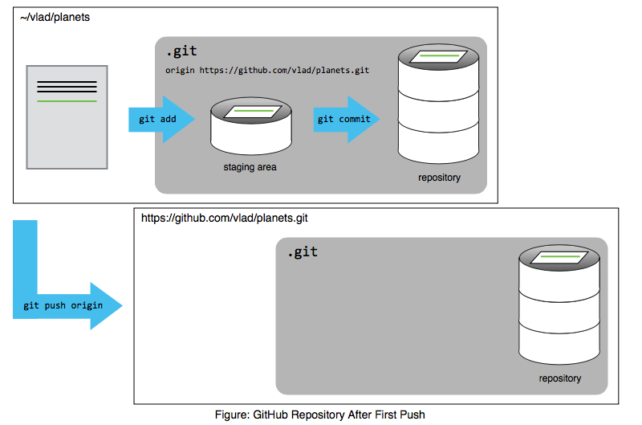

Slide 11
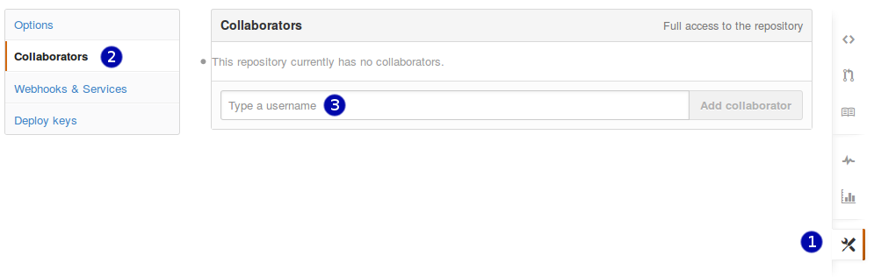

Slide 12
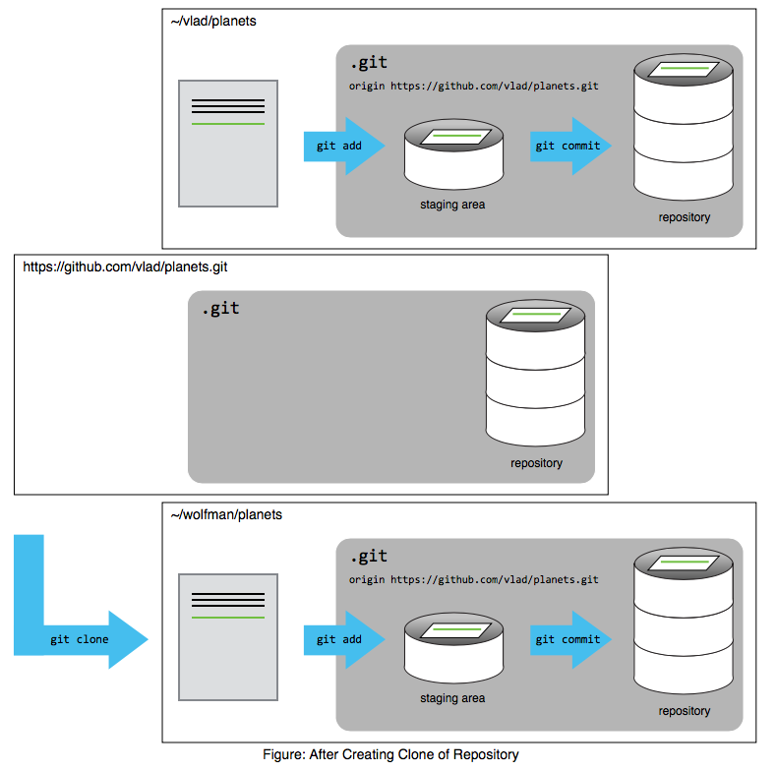

Slide 13
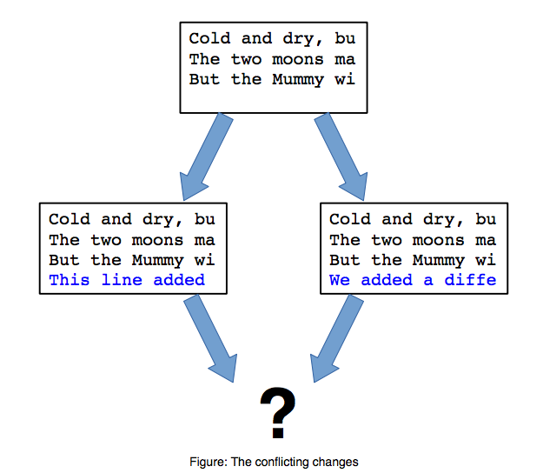

Slide 15
Review
What do the following verbs do?
Push
Pull
Clone

Slide 16
Previously…
Created a local repository
What command was that again?
Added some files, committed them
Linked the repository to the remote
What command was that again?
Nice remote backup, but…

Slide 17
Collaborating
Pair up
Identify one of the pair to “own” the planets repository – you created this during our first Git class
Add the other of the pair as a collaborator to the repository
Both clone the planets repository

Slide 18
Collaborating
Both make changes to mars.txt by adding a new line
Status, diff, add, commit, push
What happens?

Slide 19
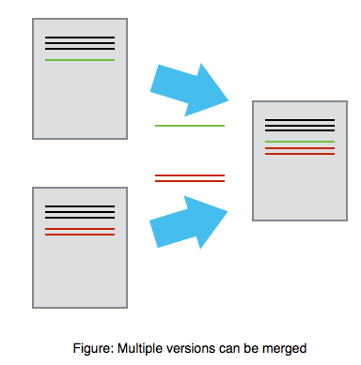
Mary
Alice

Slide 20
Collaborating
To add collaborators to a repository
Go to the repo
Click on Settings, then collaborators

Slide 23
Collaborating
What happens?
How would this work for lots of people at once?

Slide 24
Collaborating in style: Branches
Scenario
Main development trunk of codebase
Bug comes in via issue report on GitHub
You need to work on the bug but don’t want to screw up main development trunk
What to do?

Slide 25
Collaborating in style: Branches
What to do?
Branch!
Does the name master make more sense now?

Slide 26
Branches: commands
Making a new branch
git branch <branch-name>
Deleting a branch
git branch –D <branch-name>
Switching to a branch (or master)
git checkout <branch-name>
git checkout master
Making a new branch and switch in one
git checkout –b <branch-name>

Slide 27
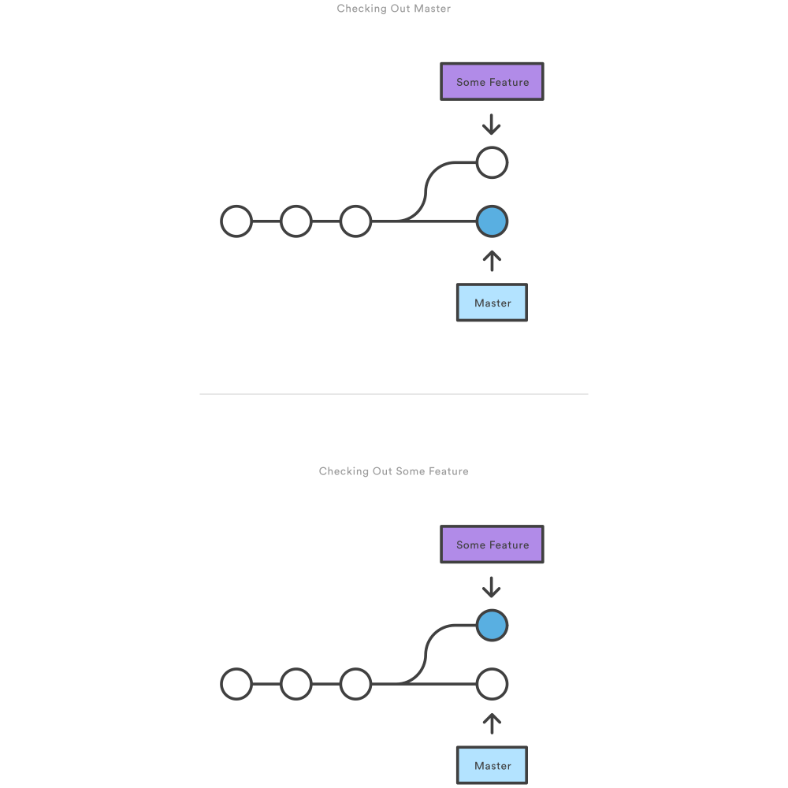
Branches: visual
After branch create
After checkout

Slide 28
Merges
But how to get our features back to master?

Slide 29
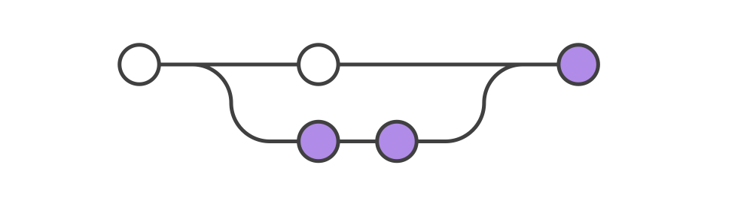
Merges
git merge <branch-name>

Slide 30
Collaborating
In class exercise...
Same partner...
Each of you will create a branch, switch to it
Make changes to the branch
Add, commit, push...
What happened?

Slide 31
Collaborating
In class exercise...
Use GitHub to view branches
Use merge to resolve conflicts
Who merged? Did you both try?

Slide 32
Yet another solution!
Use a fork!

Slide 33
Yet another solution!
Conflict management with forks

Slide 34
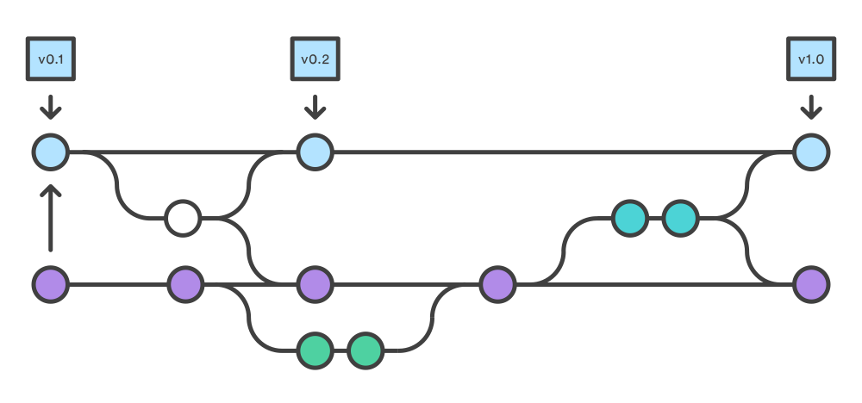
Yet another solution!
Use a fork!

Slide 35
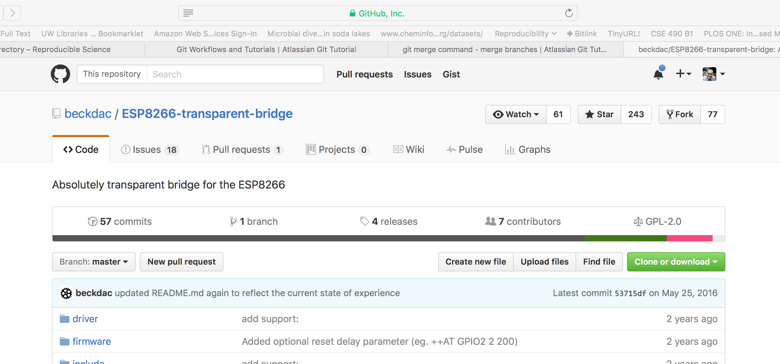
Forking a repository
Go to the repository page...
Click fork in the top right corner

Slide 36
Forking a repository
Go to your repository list
Select the `copy` or fork of the original repository
Clone your fork (not the original)
Make changes
Add, commit, push
https://help.github.com/articles/creating-a-pull-request/

Slide 37
Collaborating
In class exercise...
Same partner...
One of you will have to delete your planets repo
She will fork her partner’s planets repo
Make a change, add, submit, commit
Submit a pull request
Partner accepts
Look at changes on GitHub

Slide 38
Collaborating
Workflow differences?
Collaboration
Branches
Fork / pull request

